Slide 1

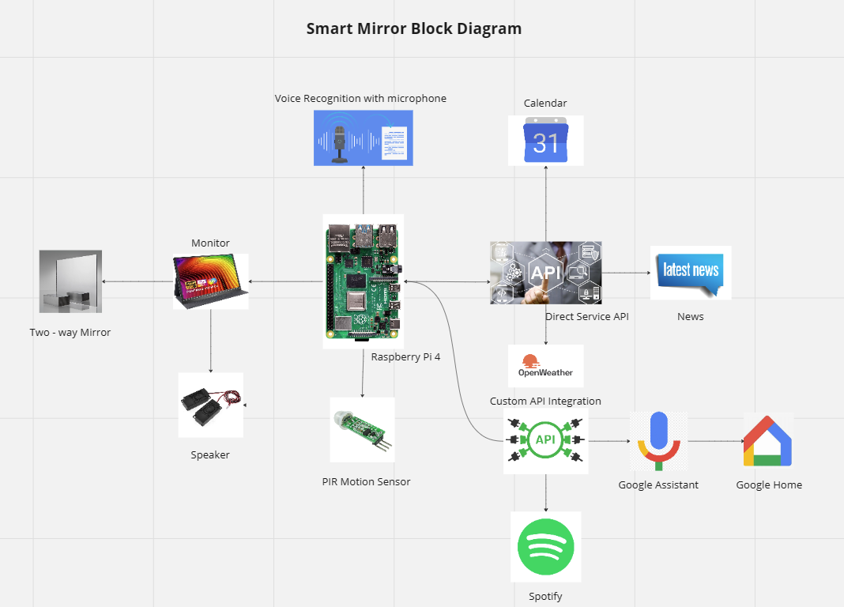
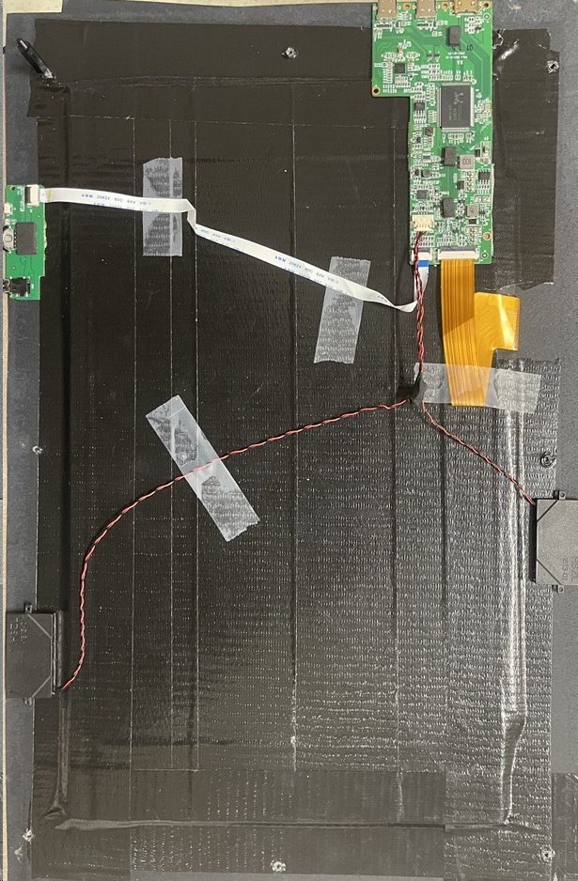
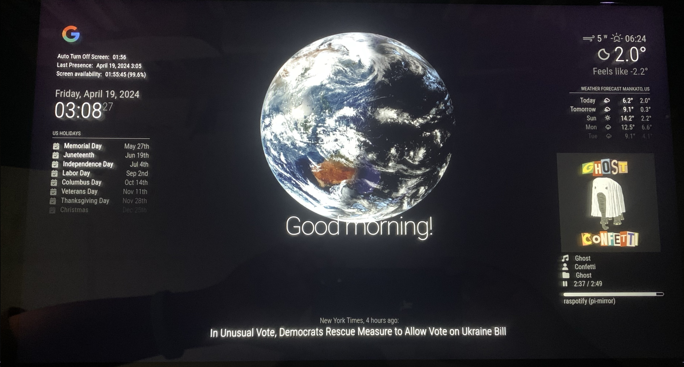
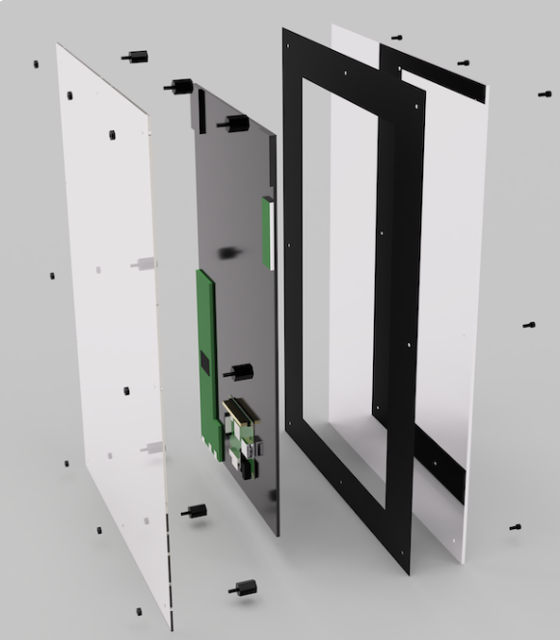
Smart Mirror
Dagmawi Abera, Hamede Abdulgafur, Noah Awol
Faculty Mentor: Dr. Puteri Megat Hamari
Minnesota State University, Mankato,
Department of Electrical & Computer Engineering & Technology
Background
The Smart Mirror's system design incorporates a suite of direct service APIs to the left of the Raspberry Pi, enhancing functionality by fetching and displaying real-time data: Google Calendar syncs personal and professional events, OpenWeatherMap provides timely weather forecasts, and the News API delivers the latest headlines, keeping users informed as they prepare for their day. Additionally, a custom Spotify API integration introduces an entertainment dimension by enabling users to access music and podcasts directly through the mirror's speakers, enriching their morning routine. The system also features voice assistance technology, allowing users to interact with the mirror using voice commands to set reminders, play music, or receive news updates, transforming the mirror from a mere reflective surface into a dynamic, interactive hub that boosts daily productivity and convenience with its technology-driven capabilities.
In today’s fast-paced world, efficiency and convenience in daily routines are more important than ever. Traditional mirrors serve a basic function but do not contribute to streamlining daily informational needs. Recognizing this gap, our team sought to enhance the everyday functionality of a traditional mirror by digitalizing it to serve as a centralized information hub. Our aim was to create a solution that not only supports personal grooming but also seamlessly integrates essential daily information, making morning routines more efficient and interactive. Additionally, the integration of digital features into household items presents an opportunity to utilize cutting-edge technology to improve everyday living.
Proposed Solution
Our proposed solution is the development of a Smart Mirror, powered by a Raspberry Pi 4 Model B, which transforms a conventional mirror into an interactive information center. The Smart Mirror is designed to display a variety of modules such as date, time, calendar, daily compliments, latest news, current weather, and weather forecasts. By leveraging the capabilities of the MagicMirror² platform, our Smart Mirror provides a customizable and modular interface that users can personalize according to their preferences and needs. This integration aims to provide users with real-time updates at a glance, enhancing their daily productivity while preparing for the day ahead. The Smart Mirror not only aims to bring a technological edge to personal spaces but also encourages user interaction by providing useful insights and updates that are tailored to the user’s lifestyle.
System Design
Figure 3: Smart Mirror Block Diagram
The Smart Mirror project is designed around a central computing unit, the Raspberry Pi 4 Model B, which orchestrates all functionalities of the smart mirror. This device handles the processing and integration of various hardware components and software services, ensuring a seamless user experience.
Hardware Integration:
To the right of the Raspberry Pi, the system includes a monitor positioned behind a two-way mirror, providing the visual output for the smart mirror. This setup allows the display of time, weather, calendar events, news, and personalized content like compliments or motivational quotes directly on the mirror's surface. Voice recognition capabilities are enabled through a connected microphone, allowing for hands-free operation and interaction with the mirror. A speaker system is integrated to deliver audio output, including news readouts or voice feedback from the mirror. Additionally, a motion sensor is incorporated to detect user presence, activating the mirror when someone approaches and switching it to a low-power mode when no activity is detected within a 2-minute threshold.
Results and Discussion
We successfully developed a fully functional Smart Mirror, integrating features such as calendar events, weather forecasts, and news updates via the Raspberry Pi and MagicMirror² platform. The inclusion of a custom Spotify API enables audio playback directly through the mirror’s speakers, while voice recognition allows for effortless hands-free control. This project demonstrates the practical application of interactive digital mirrors, enhancing daily routines with technology-driven convenience and functionality.
Figure 4: Fully Functional Smart Mirror
Conclusions and Future Work
Our Smart Mirror project has successfully merged digital technology with traditional functionality, transforming a simple mirror into a comprehensive interactive hub for accessing real-time information and multimedia. Looking ahead, we aim to expand the mirror’s capabilities by exploring facial recognition for personalized user interactions, improving energy efficiency, and integrating with other smart home devices. Additionally, developing a mobile app for remote customization and control represents a promising direction for enhancing user engagement and convenience.
Conclusions and Future Work
Figure 1: Electronic parts mounted on a screen
Acknowledgment
We extend our heartfelt thanks to the ECET Department for their support and guidance throughout this project. Special gratitude to the URC for their generous funding grant, Dr. Hamari for her invaluable mentorship, and Jeni, the ECET Admin Assistant, who was instrumental in facilitating our purchases and logistics.
References
How to build a super-slim smart mirror - Raspberry Pi. (n.d.). Raspberry Pi. https://www.raspberrypi.com/tutorials/how-to-build-a-super-slim-smart-mirror/ HootieStyleChannel. (n.d.). YouTube. https://www.youtube.com/playlist?list=PLtkX2gOMBoVODOkil56UYYu46l91xzMJO
Figure 2: Hardware Assembly

